Slide 2
solve different problems based on series completion.

Slide 3
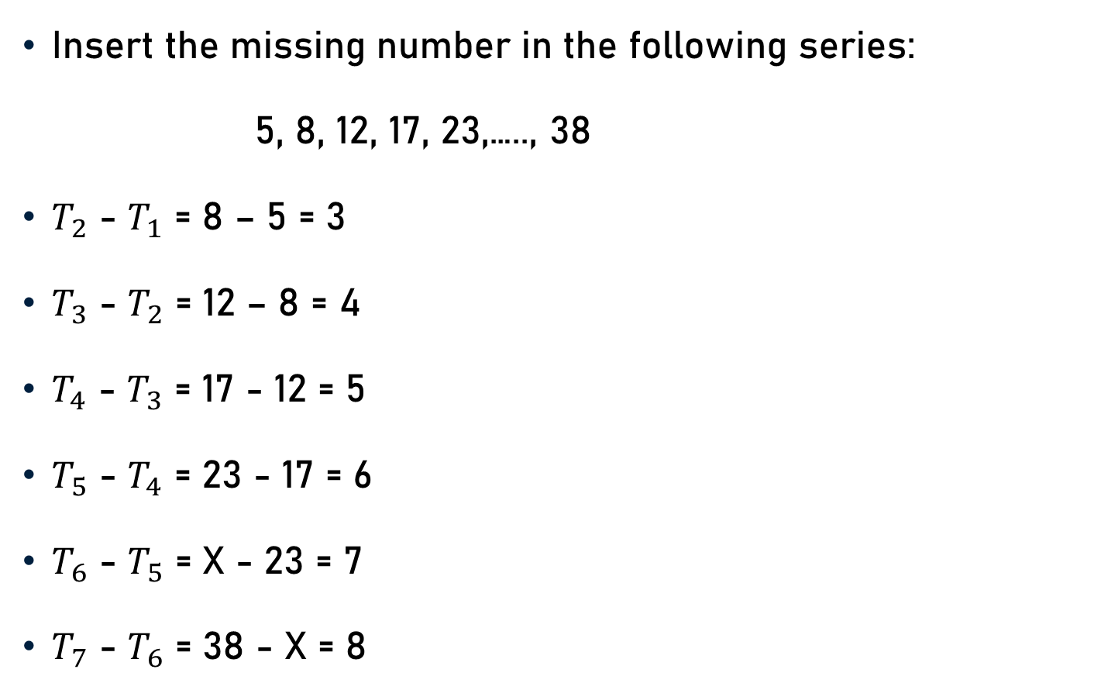
Problem 1
Insert the missing number in the following series:
5, 8, 12, 17, 23,….., 38
$T_{2}$ - $T_{1}$ = 8 – 5 = 3
$T_{3}$ - $T_{2}$ = 12 – 8 = 4
$T_{4}$ - $T_{3}$ = 17 - 12 = 5
$T_{5}$ - $T_{4}$ = 23 - 17 = 6
$T_{6}$ - $T_{5}$ = X - 23 = 7
$T_{7}$ - $T_{6}$ = 38 - X = 8
?

Slide 4
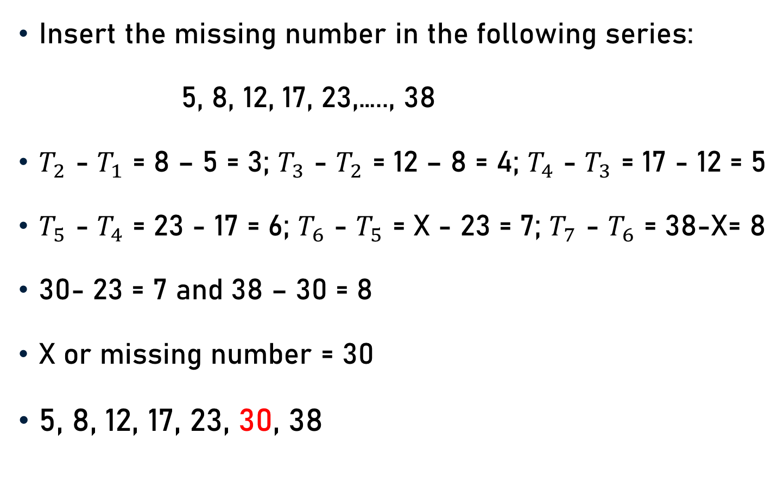
Problem 1
Insert the missing number in the following series:
5, 8, 12, 17, 23,….., 38
$T_{2}$ - $T_{1}$ = 8 – 5 = 3; $T_{3}$ - $T_{2}$ = 12 – 8 = 4; $T_{4}$ - $T_{3}$ = 17 - 12 = 5
$T_{5}$ - $T_{4}$ = 23 - 17 = 6; $T_{6}$ - $T_{5}$ = X - 23 = 7; $T_{7}$ - $T_{6}$ = 38-X= 8
30- 23 = 7 and 38 – 30 = 8
X or missing number = 30
5, 8, 12, 17, 23, 30, 38

Slide 5
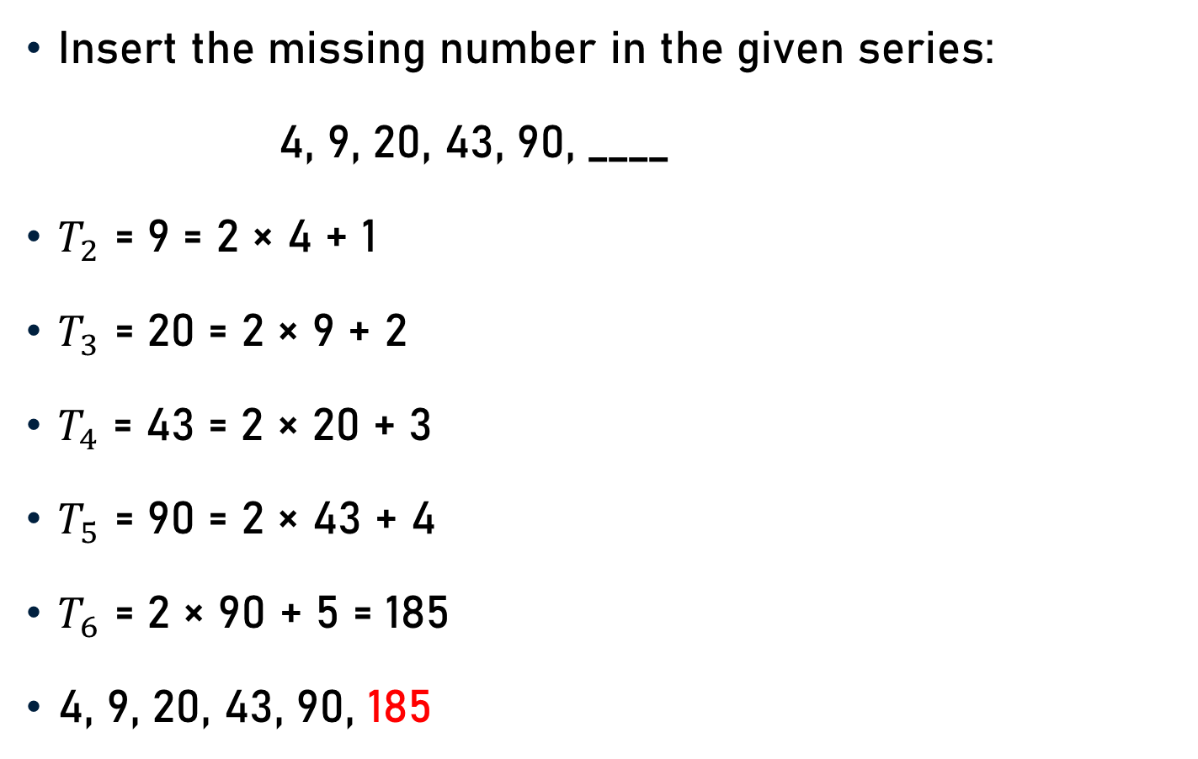
Problem 2
Insert the missing number in the given series:
4, 9, 20, 43, 90, ____
$T_{2}$ = 9 = 2 × 4 + 1
$T_{3}$ = 20 = 2 × 9 + 2
$T_{4}$ = 43 = 2 × 20 + 3
$T_{5}$ = 90 = 2 × 43 + 4
$T_{6}$ = 2 × 90 + 5 = 185
4, 9, 20, 43, 90, 185
?

Slide 6
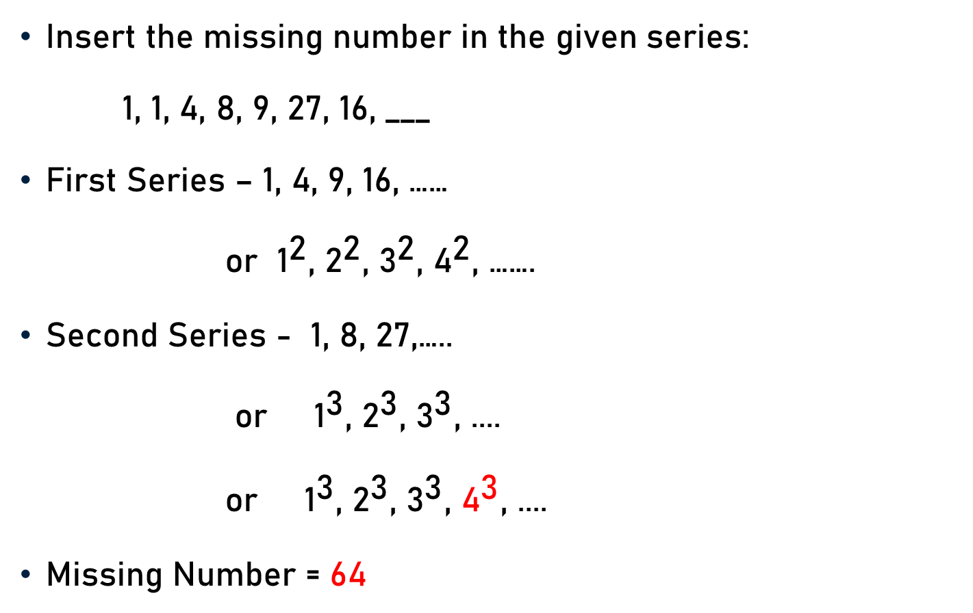
Problem 3
Insert the missing number in the given series:
1, 1, 4, 8, 9, 27, 16, ___
First Series – 1, 4, 9, 16, ……
or ${\text{1}}^{\text{2}}$, ${\text{2}}^{\text{2}}$, ${\text{3}}^{\text{2}}$, ${\text{4}}^{\text{2}}$, …….
Second Series - 1, 8, 27,…..
or ${\text{1}}^{\text{3}}$, ${\text{2}}^{\text{3}}$, ${\text{3}}^{\text{3}}$, ....
or ${\text{1}}^{\text{3}}$, ${\text{2}}^{\text{3}}$, ${\text{3}}^{\text{3}}$, ${\text{4}}^{\text{3}}$, ....
Missing Number = 64
?
?

Slide 7
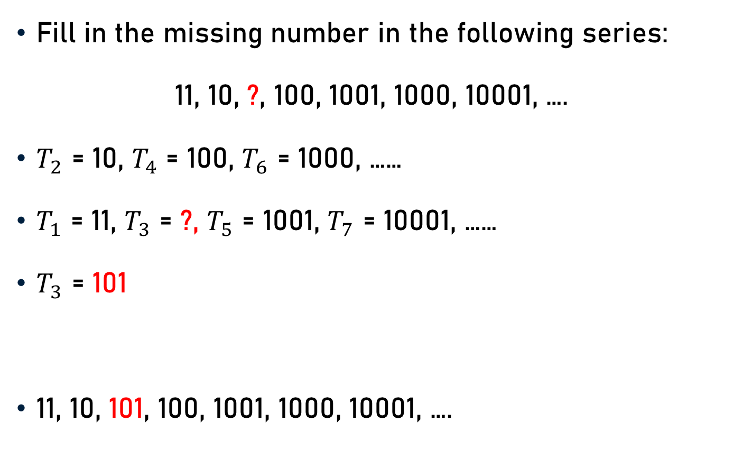
Problem 4
Fill in the missing number in the following series:
11, 10, ?, 100, 1001, 1000, 10001, ….
$T_{2}$ = 10, $T_{4}$ = 100, $T_{6}$ = 1000, ……
$T_{1}$ = 11, $T_{3}$ = ?, $T_{5}$ = 1001, $T_{7}$ = 10001, ……
$T_{3}$ = 101
11, 10, 101, 100, 1001, 1000, 10001, ….

Slide 8
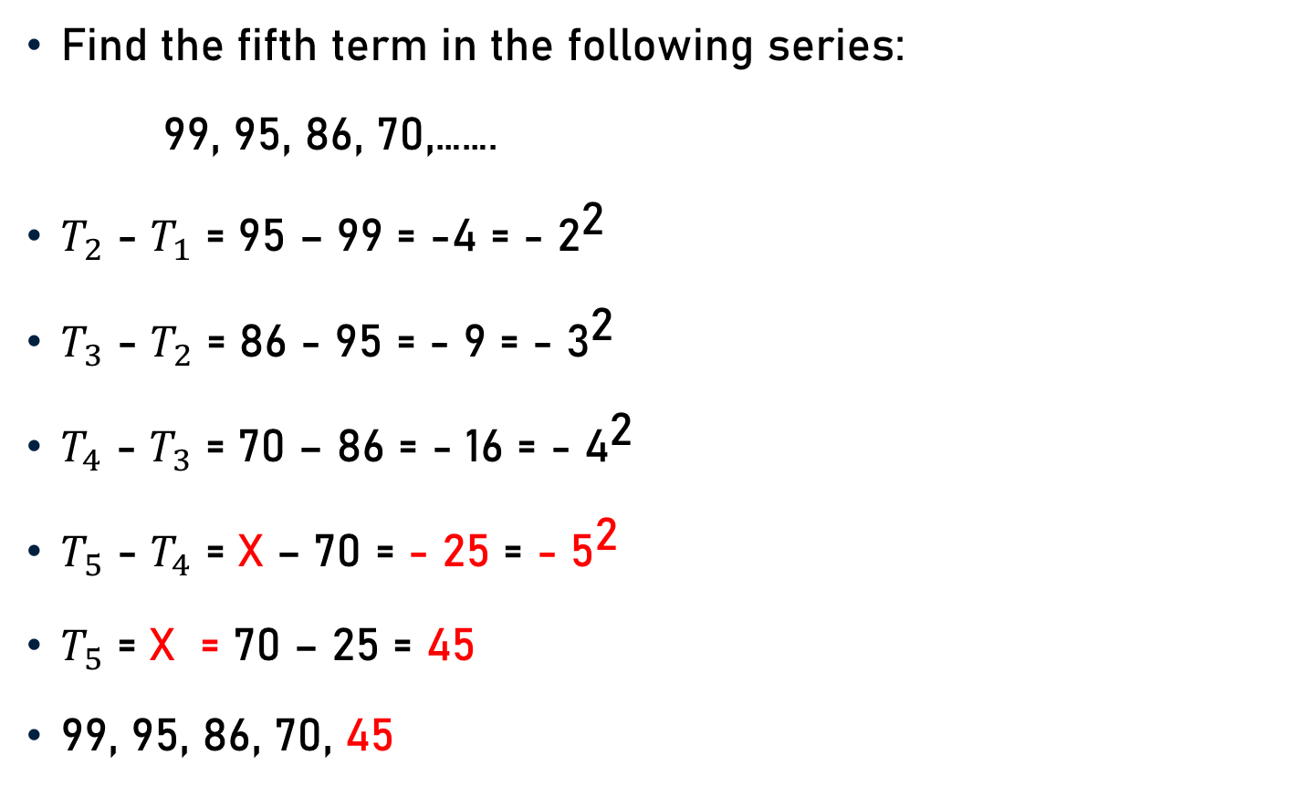
Problem 5
Find the fifth term in the following series:
99, 95, 86, 70,…….
$T_{2}$ - $T_{1}$ = 95 – 99 = -4 = - ${\text{2}}^{\text{2}}$
$T_{3}$ - $T_{2}$ = 86 - 95 = - 9 = - ${\text{3}}^{\text{2}}$
$T_{4}$ - $T_{3}$ = 70 – 86 = - 16 = - ${\text{4}}^{\text{2}}$
$T_{5}$ - $T_{4}$ = X – 70 = - 25 = - ${\text{5}}^{\text{2}}$
$T_{5}$ = X = 70 – 25 = 45
99, 95, 86, 70, 45
?

Slide 9
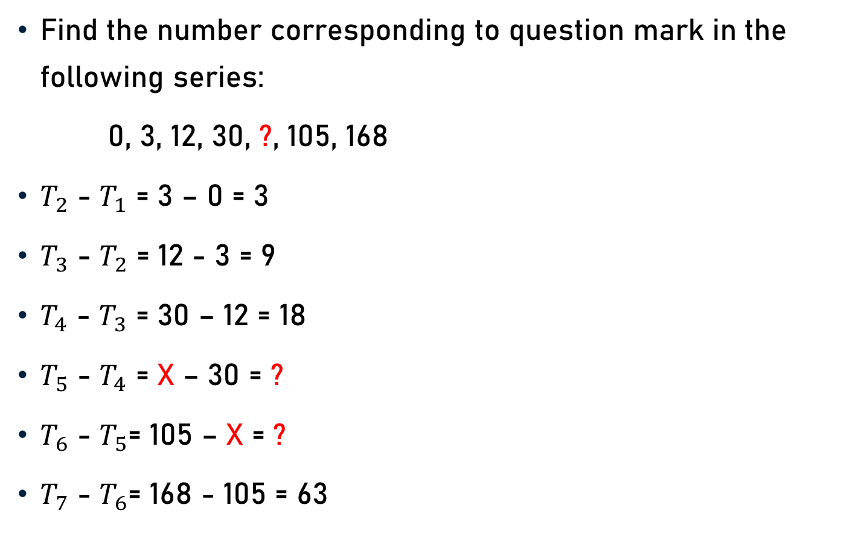
Problem 5
Find the number corresponding to question mark in the following series:
0, 3, 12, 30, ?, 105, 168
$T_{2}$ - $T_{1}$ = 3 – 0 = 3
$T_{3}$ - $T_{2}$ = 12 - 3 = 9
$T_{4}$ - $T_{3}$ = 30 – 12 = 18
$T_{5}$ - $T_{4}$ = X – 30 = ?
$T_{6}$ - $T_{5}$= 105 – X = ?
$T_{7}$ - $T_{6}$= 168 - 105 = 63

Slide 10
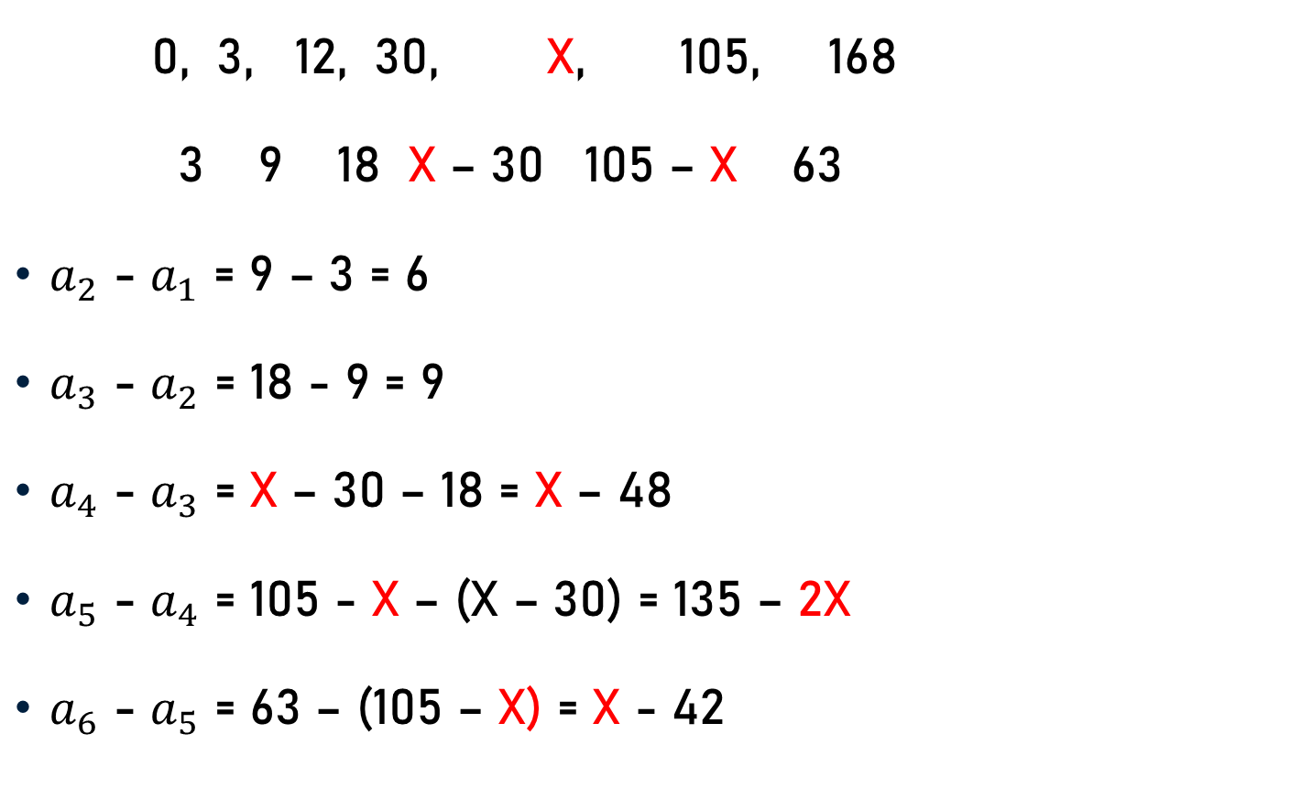
Problem 5
0, 3, 12, 30, X, 105, 168
3 9 18 X – 30 105 – X 63
$a_{2}$ - $a_{1}$ = 9 – 3 = 6
$a_{3}$ - $a_{2}$ = 18 - 9 = 9
$a_{4}$ - $a_{3}$ = X – 30 – 18 = X – 48
$a_{5}$ - $a_{4}$ = 105 - X – (X – 30) = 135 – 2X
$a_{6}$ - $a_{5}$ = 63 – (105 – X) = X - 42

Slide 11
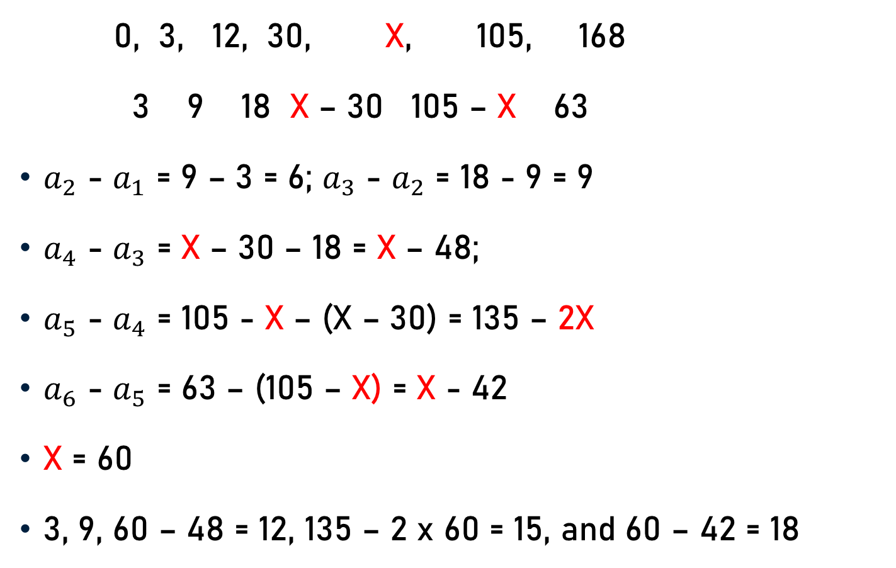
Problem 5
0, 3, 12, 30, X, 105, 168
3 9 18 X – 30 105 – X 63
$a_{2}$ - $a_{1}$ = 9 – 3 = 6; $a_{3}$ - $a_{2}$ = 18 - 9 = 9
$a_{4}$ - $a_{3}$ = X – 30 – 18 = X – 48;
$a_{5}$ - $a_{4}$ = 105 - X – (X – 30) = 135 – 2X
$a_{6}$ - $a_{5}$ = 63 – (105 – X) = X - 42
X = 60
3, 9, 60 – 48 = 12, 135 – 2 x 60 = 15, and 60 – 42 = 18

Slide 12
Problem 6
Find out the wrong number in the following series:
455, 445, 465, 435, 485, 415, and 475
455, 465, 485, and 475
465 - 455 = 10; 485 – 465 = 20; and 475 – 485 = -10
445, 435, and 415
435 – 445 = -10; and 415 - 435 = -20
Correct number = 485 + 30 = 515

Slide 13
Problem 7
Find out the wrong number in the following series:
1, 5, 11, 19, 29, and 55
5 - 1 = 4
11 –5 = 6
19 – 11 = 8
29 – 19 = 10
55 -29 = 26
Correct number = 29 + 12 = 41

Slide 14
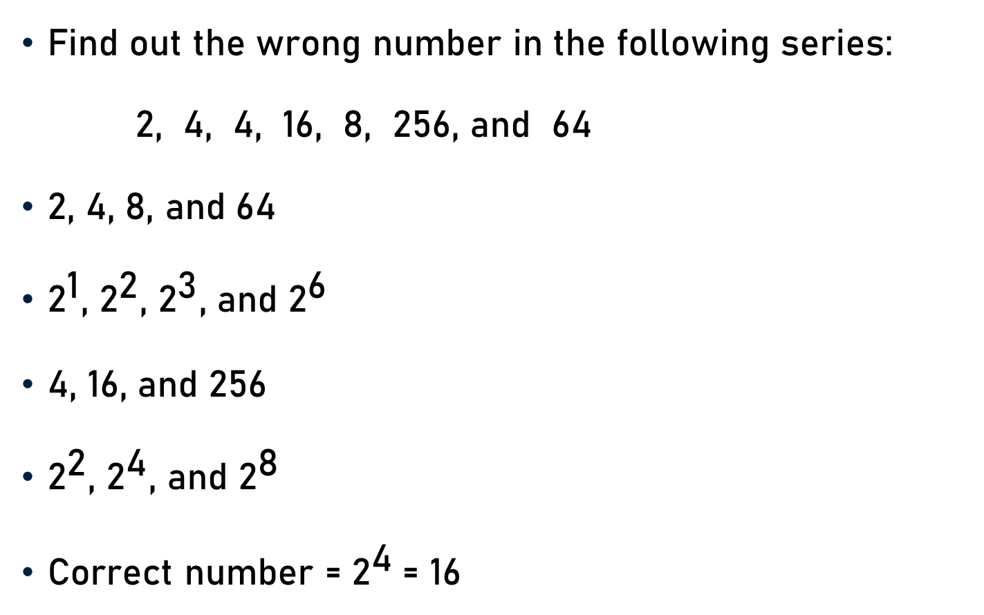
Problem 8
Find out the wrong number in the following series:
2, 4, 4, 16, 8, 256, and 64
2, 4, 8, and 64
${\text{2}}^{\text{1}}$, ${\text{2}}^{\text{2}}$, ${\text{2}}^{\text{3}}$, and ${\text{2}}^{\text{6}}$
4, 16, and 256
${\text{2}}^{\text{2}}$, ${\text{2}}^{\text{4}}$, and ${\text{2}}^{\text{8}}$
Correct number = ${\text{2}}^{\text{4}}$= 16

Slide 15
Problem 9
In the following questions a number series is given. After the series a number is given followed by a, b, c, d and e. Complete the series starting with the number given following the sequence of the given series.
1, 9, 65, 393
2, a, b, c, d, e
9 = 1 x 8 + 1
65 = 9 x 7 + 2
393 = 65 × 6 + 3

Slide 16
Problem 9
1, 9, 65, 393
2, a, b, c, d, e
9 = 1 x 8 + 1; 65 = 9 x 7 + 2; 393 = 65 × 6 + 3
a = 2 x 8 + 1 = 17
b = 17 × 7 + 2 = 121
c = 121 x 6 + 3 = 729
d = 729 x 5 + 4 = 3649
e = 3649 × 4 + 5 = 14601

Slide 17
Problem 10
Find out the wrong number in the following series:
3, 10, 24, 54, 108, 220, and 444
10 = 2 × 3 + 4
24 = 2 × 10 + 4
54 = 2 × 24 + 6
108 = 2 × 54 + 0
220 = 2 × 108 + 4
444 = 2 × 220 + 4
Correct number 52 = 2 × 24 + 4 and 108 = 2 x 52 + 4

Slide 18
Conclusion
Pattern - Series
Missing Number/Wrong Number
Complete/Correct Series

Slide 19
Summary
Problems - Series Completion

